Slide 1
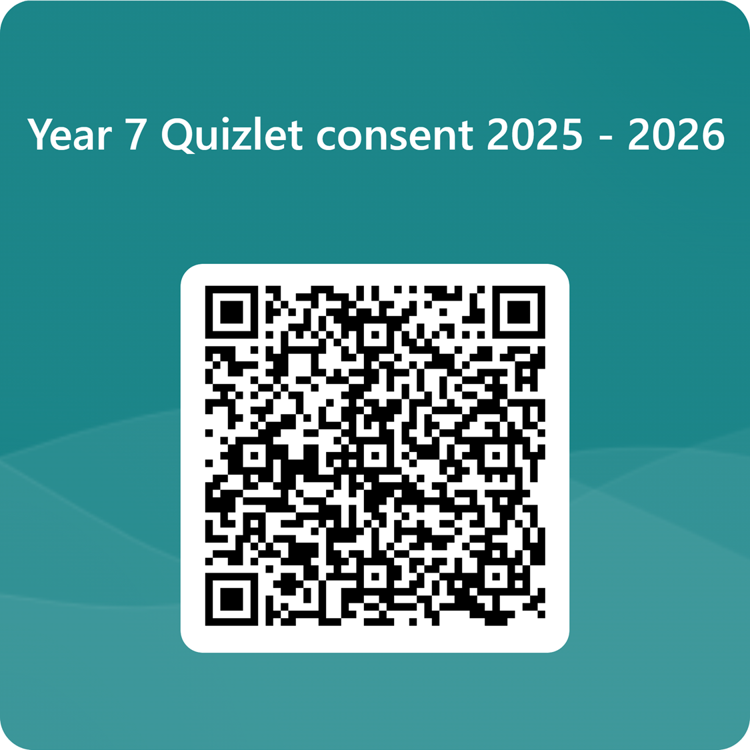
Meet the Tutor evening
18th September 2025

Slide 2
The Year 7 pastoral team
Head of Year: Mrs Burgess​
Assistant Head of Year: Mr Roberts​
Deputy Principal: Mr Sycamore​
​
Tutors ​
7C – Mrs Goodson and Miss Van De Graaf in Art2​
7O – Mr R Law in Ma1​
7M – Mr Winter in Ma4​
7B – Mrs Allen and Mr Shelley in Ma2​
7I – Miss Sankaran in Ge3​
7E – Miss Everitt and Mr P Law in Ma7​
7R – Mr Collier in Ma3​
7T – Mr Garton in Ma5​
7N – Ms Dunn in Ma6​
7V – Miss Allinson in Ge2​

Slide 3
What are staff saying about Year 7 so far…?
“All my Year 7 teaching groups are lovely!”
“What a delightful year group!”
“I am so impressed with their enthusiasm!”
“Year 7 are so polite and already saying thank you at the end of lessons.”

Slide 4
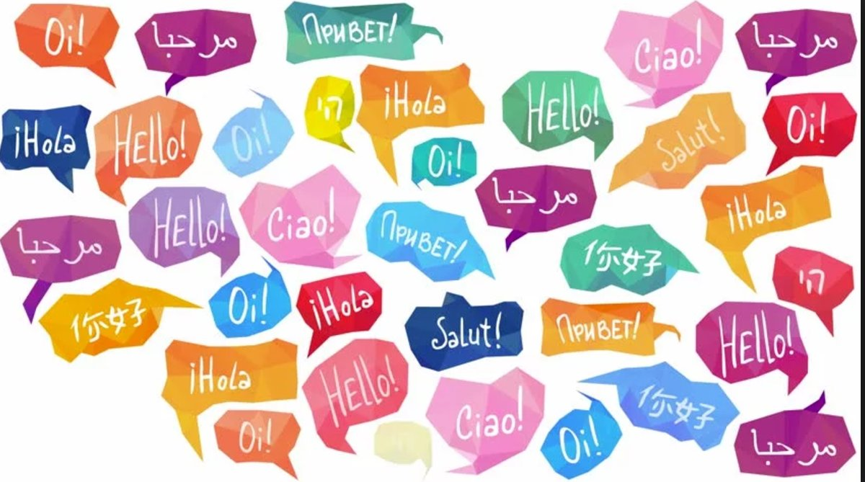
International Talent evening
Wednesday 15th October in the Performance Hall
‘Spanglovision’
A celebration of our international principle
ThePhoto by PhotoAuthor is licensed under CCYYSA.

Slide 5
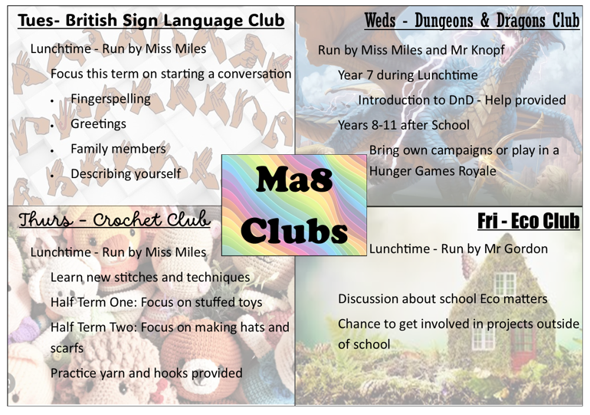
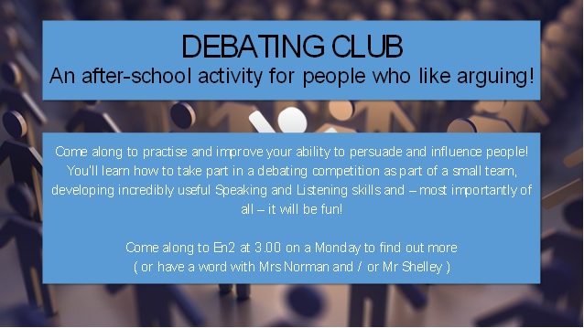
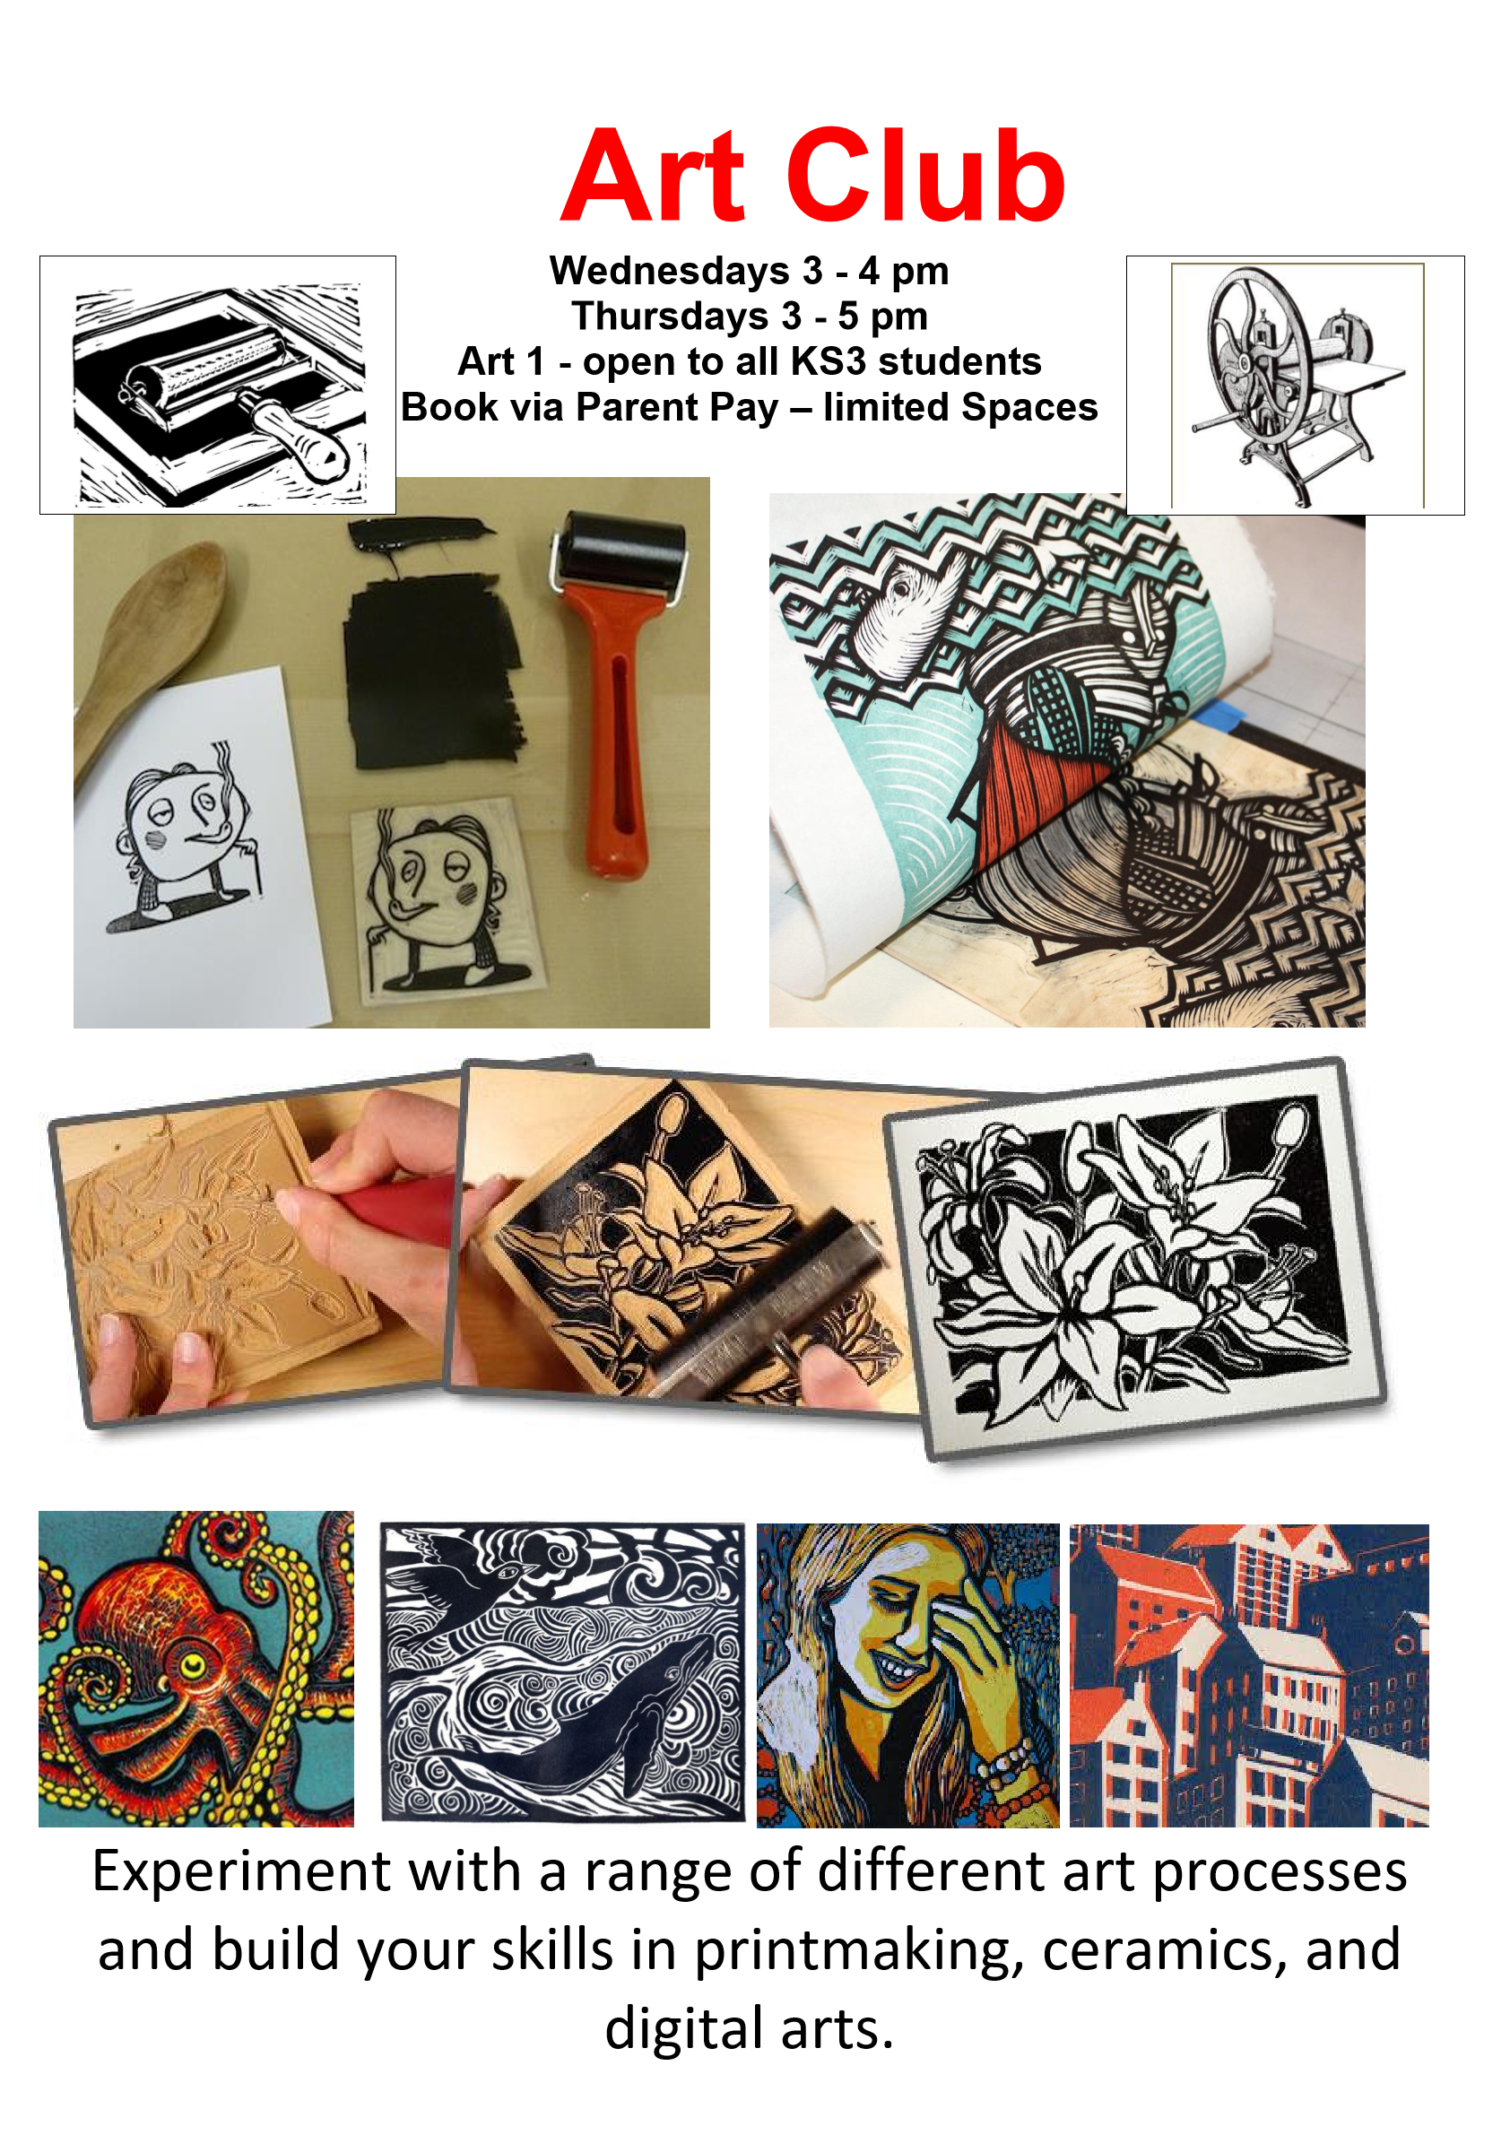
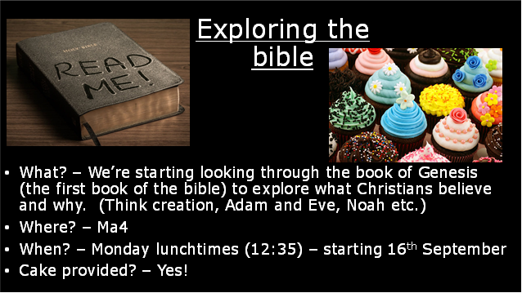
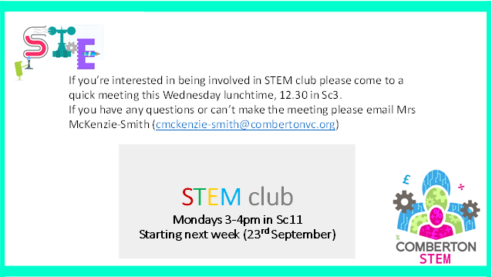


Notes:
Suzanne

Slide 6
Autumn extra-curricular clubs 2025
Key details:
All clubs are free and you can attend as many as you wish!
There is no sign-up required (just turn up), other than Climbing club (Sign up at the PE office).
No equipment required, students just need to get changed into the appropriate school PE kit (shinpads for football/ hockey, gumshield for rugby).
All after school clubs run from 3-4pm.
Any questions please see Mr Anderson
All clubs commence from the 15th September
Notes:
Suzanne

Slide 7

Music department activities
Autumn term 2025
Day/Time | Lunchtime (12.40 – 1.05pm) |  | After School (3-4pm)
Monday | Flute Choir (all years) - Mu 2 Soul Band (all Years) - Mu1 |  | Concert Band (all years) - Mu 1
Tuesday | String Ensemble (all years) - Mu 1 Music Theory Support drop - Mu 3
Wednesday | Woodwind Ensemble (all years) - Mu 2 Snare Drum Group (all years) – Mu 1 |  | Orchestra (all years) - Mu 1
Thursday | Upper School Choir (years 9+) - Mu 1 Brass Ensemble (all years) - Mu 2
Friday | Comberton Young Voices (Yrs 7-9) Mu 1 |  | Big Band (all years) - Mu 1
All students participating in any of the above clubs are asked to contribute towards running costs. £10 per child or £12 per family for unlimited music clubs per term, payable via ParentPay. Please click on the activity name to complete the registration form before attending as spaces maybe limited. Any queries, please speak to a member of staff in Music Department. Look out for new clubs starting soon!
Notes:
Suzanne

Slide 8
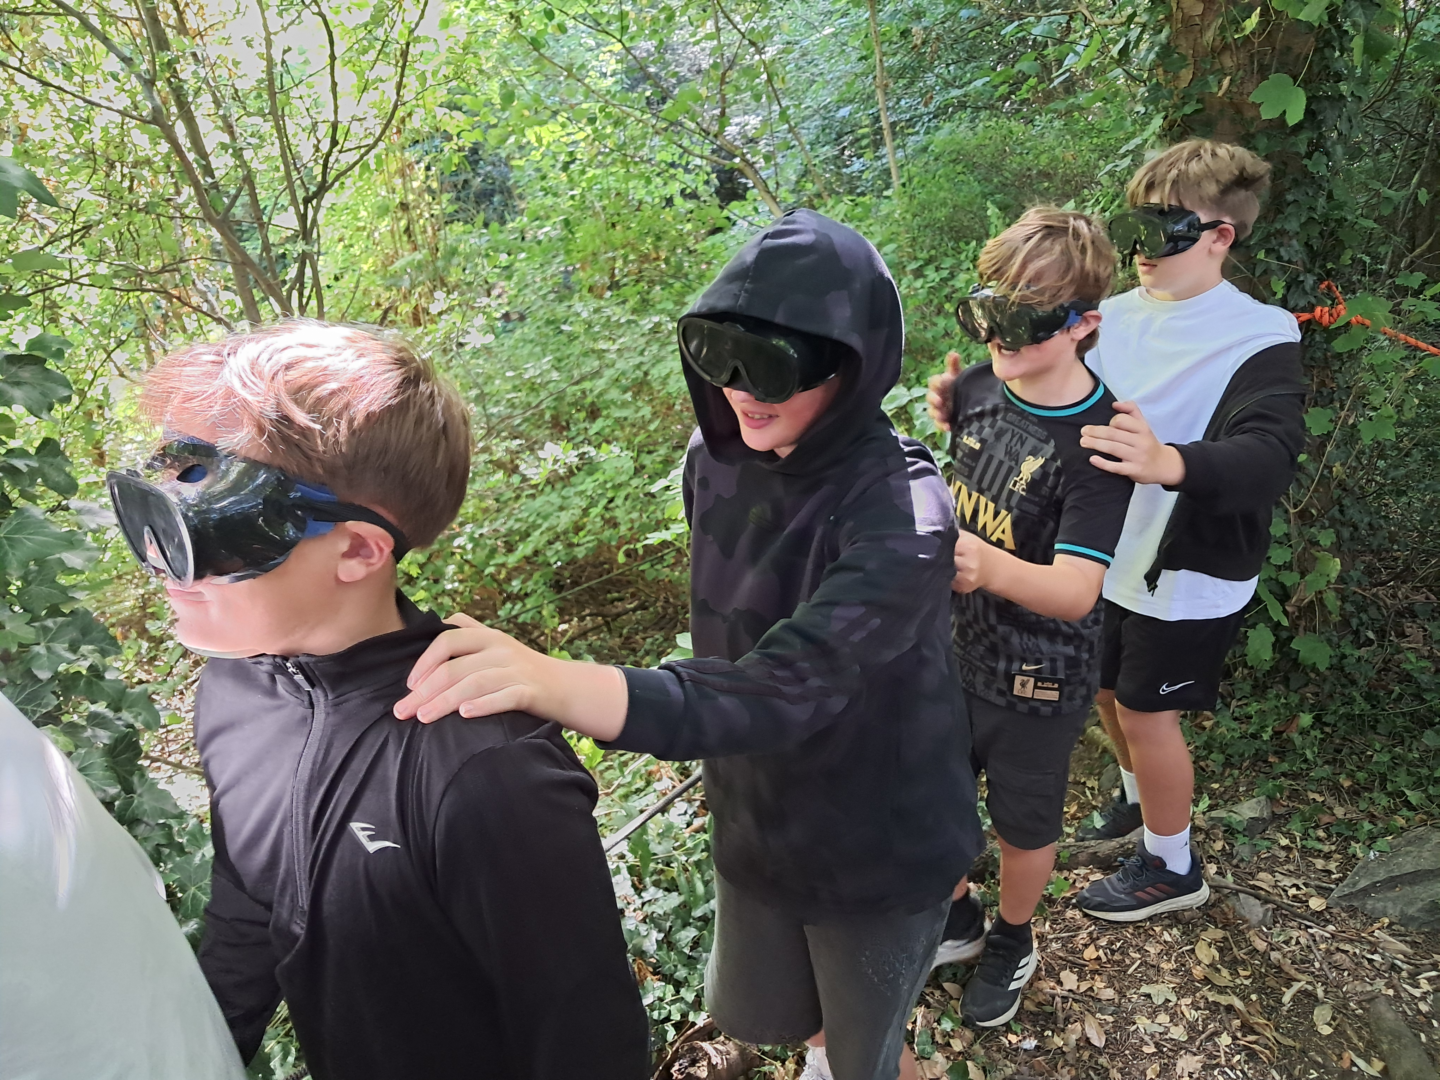
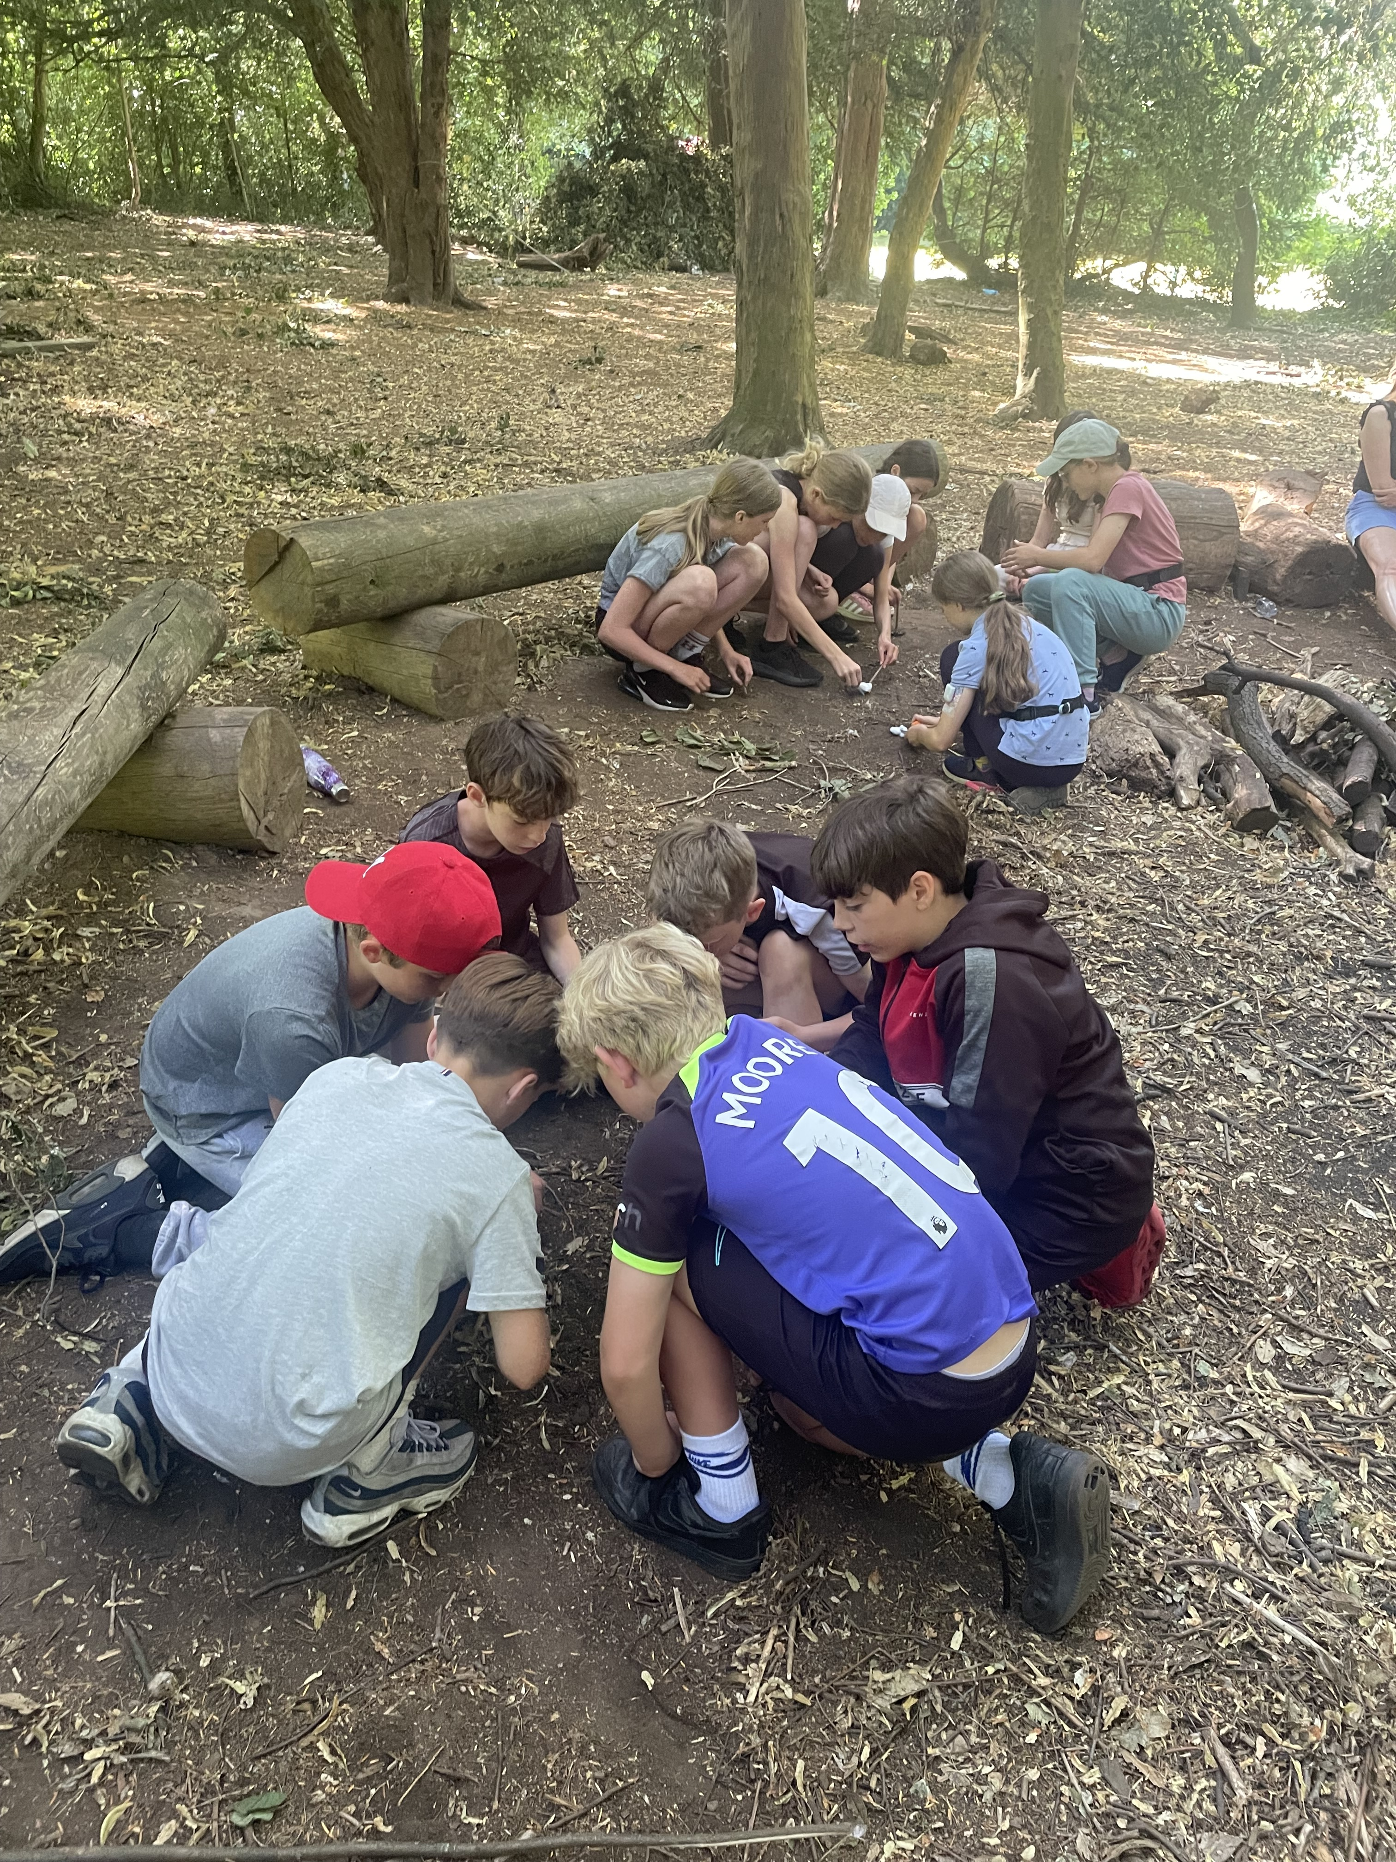
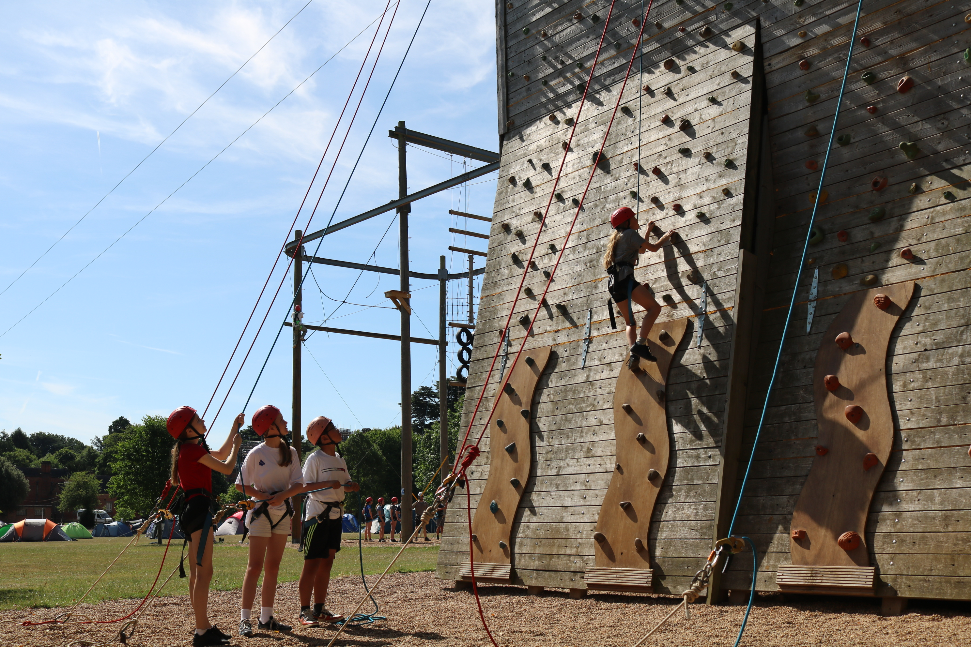
Beaumanor 2026
Week beginning 6th July

Slide 9
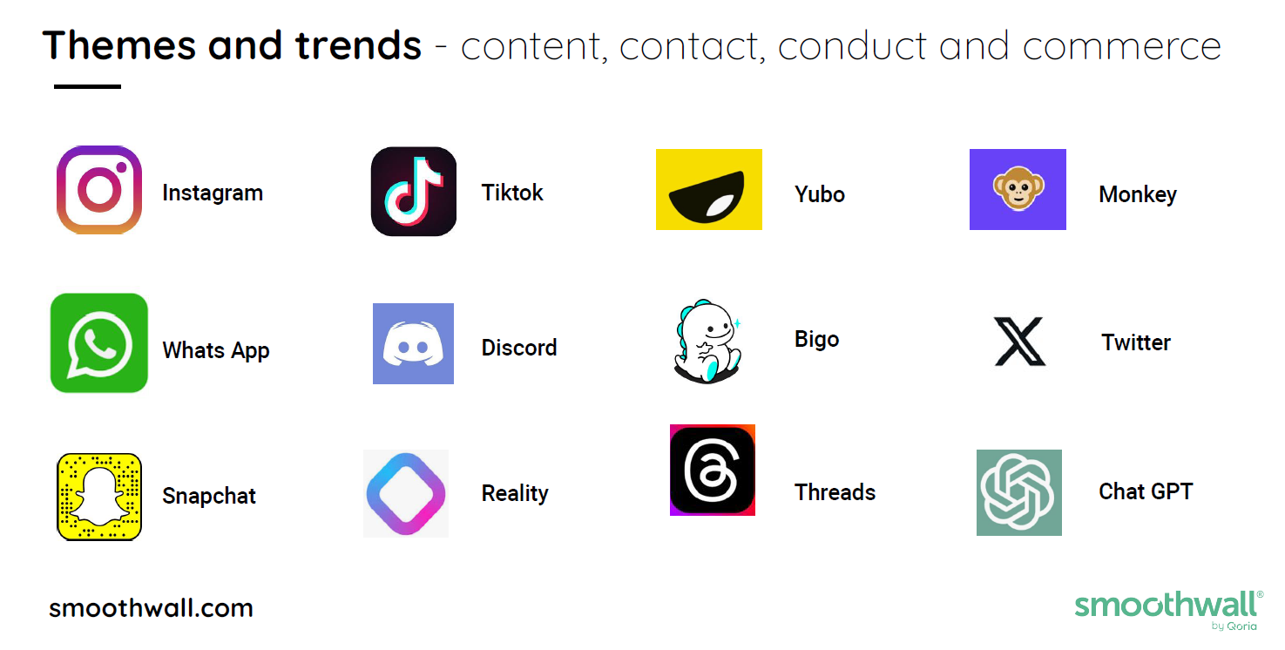
E-Safety- how you can help your child navigate safely online
None of the above apps should be available to children under 13- watch out for children hiding Apps.
Notes:
Suzanne on Esafety
Bigo- is a live streaming platform
Yubo is a social media app that encourages teens to find new friends to swipe left or right and connect to live stream
Monkey- live streaming app
Reality- allows you to make an avatar but also links to live streaming

Slide 10
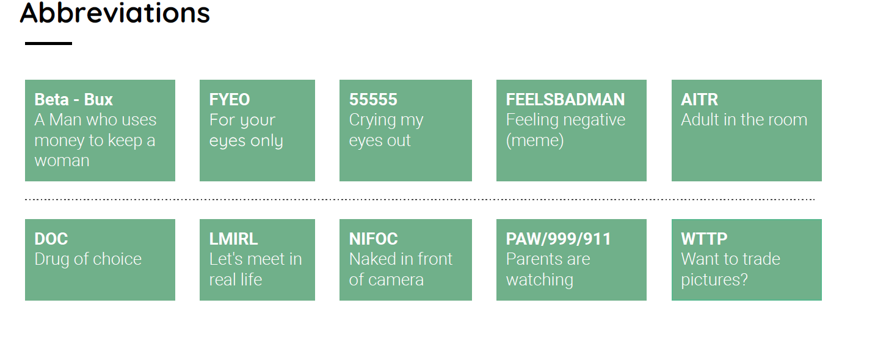
If your child has a smartphone make sure it has privacy setting all set up and that it cannot receive and store images- especially from WhatsApp younger children do misuse this.
Talk with your child and create agreements and open discussion- they will then find it easier to ask for help.- more advice is available here:TALK Checklist by Internet Watch Foundation | Home and via our website.
Any social media concerns you can report them to the site and here: www.reportharmfulcontent.com- they will help and guide you through what to do outside of school.
Notes:
Suzanne

Slide 11
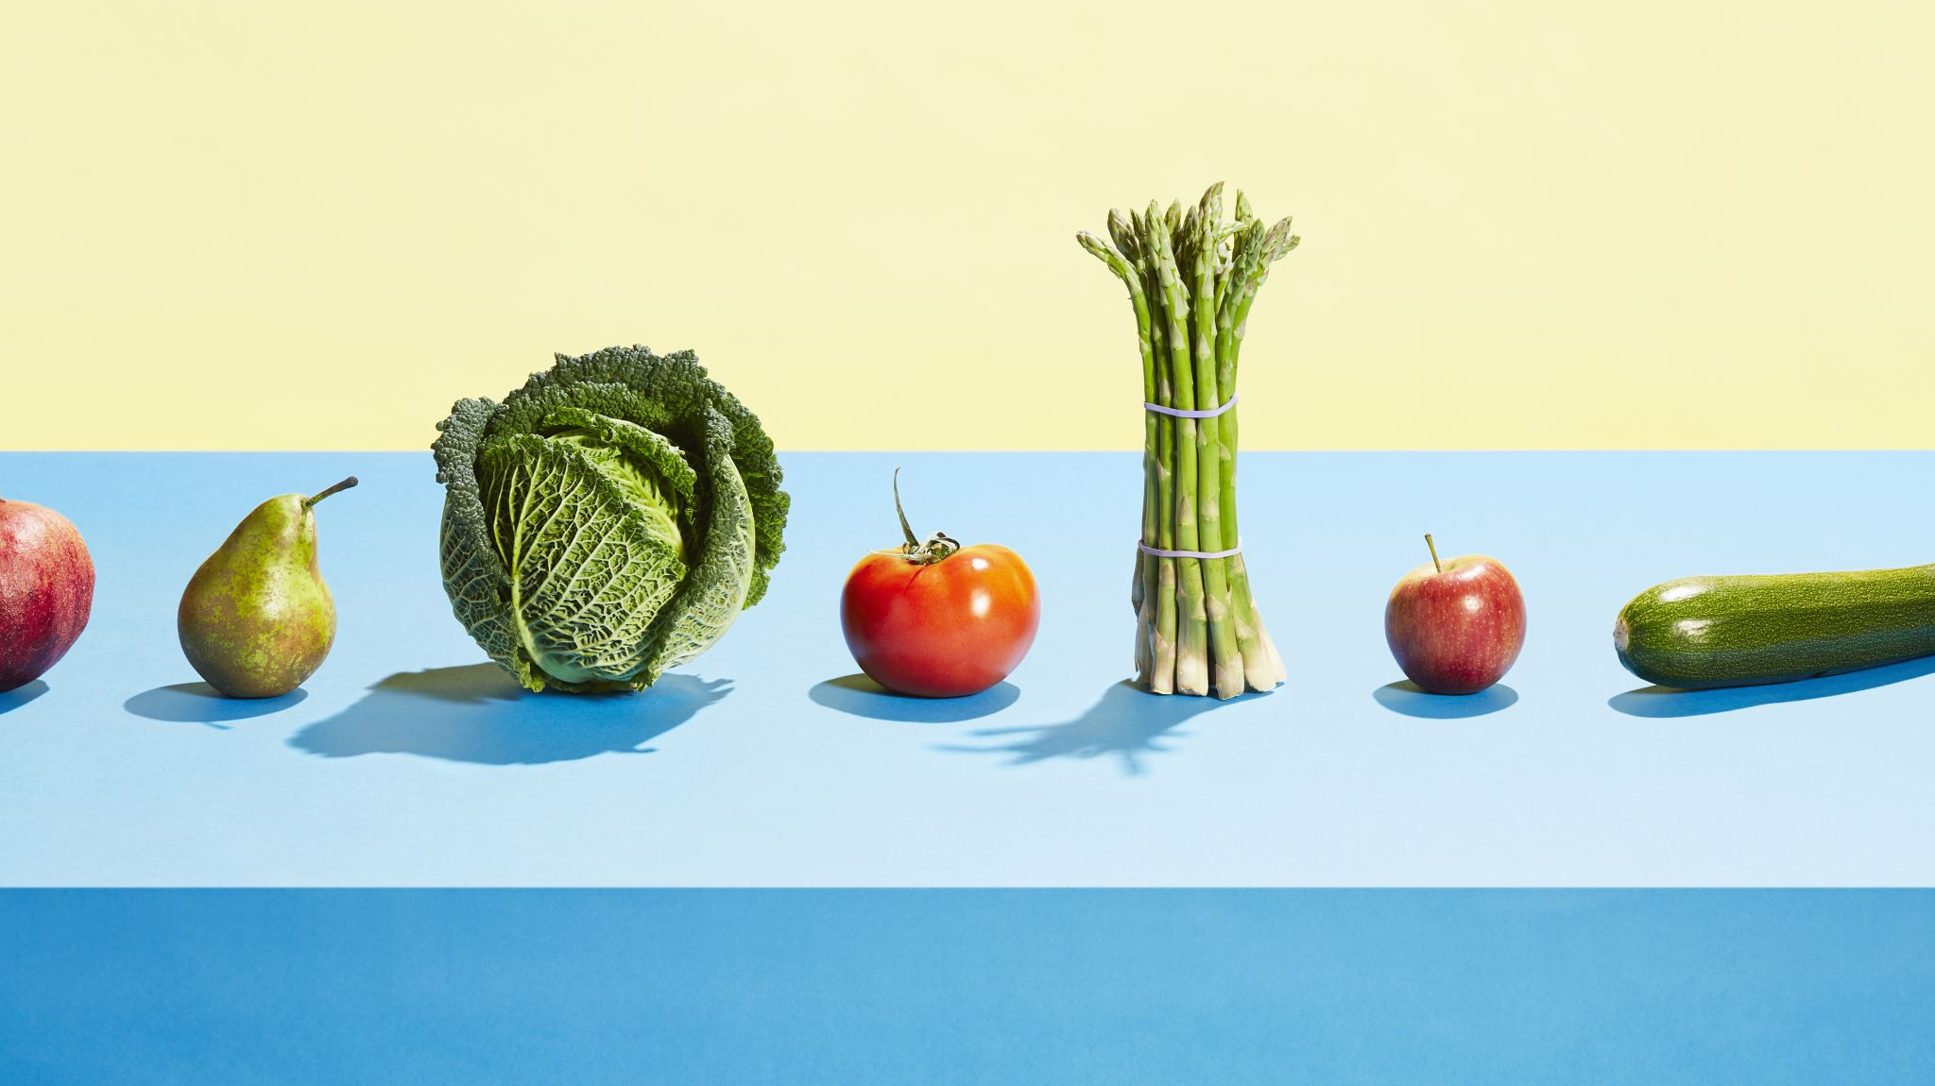
Supporting your child in making healthy food choices in school
Notes:
Emily G

Slide 12
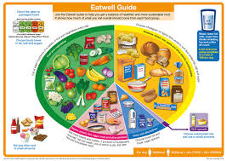
Tips to help support your child’s food choice at school
Encourage your child to choose a vegetable with their main meal.
Encourage your child to access the dining hall, not just the buttery. Delicious freshly cooked meals are freshly prepared each day.
Puddings should be eaten as part of a lunch.
Track and discuss your child’s selections- their food choices are unsupervised.
We teach our pupils to use the Eatwell guide to help choose the right food groups in the correct proportions.
Notes:
Emily

Slide 13
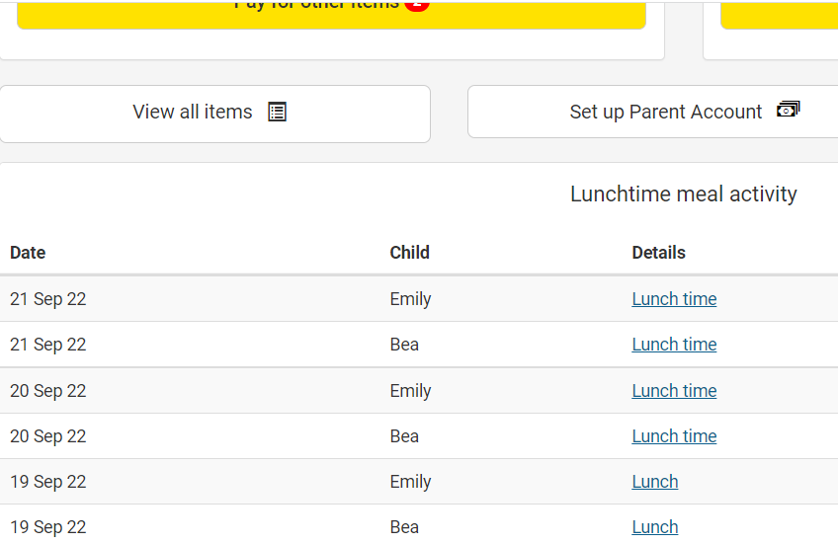
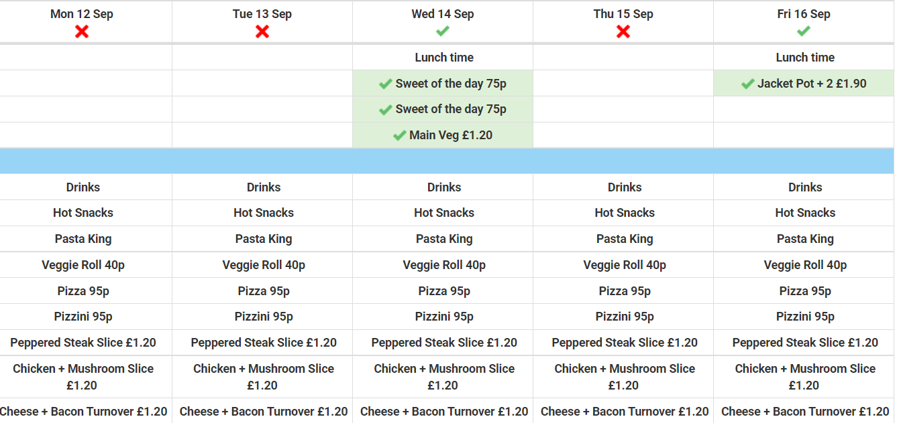
Tracking food choices
Click on the link here…
…to see what food choices have been made each day.
You may need to scroll down through the menu
Notes:
Emily

Slide 14
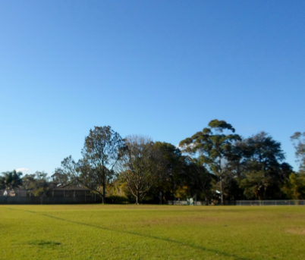
Year 7 social events
Social events help to build new friendships, within and across the year group.
Social events create a sense of belonging.
Social events create pupil memories of their time at CVC.
Social events help with enjoyment and feeling positive!
Aim for one social event per term.
First social event is on Wednesday 22nd October - DISCO!
Notes:
James

Slide 15
Personal Development
Year 7 - TOPIC 1: Health and well-being
Menstruation – assembly (Monday)
Free resources – 'Ending period poverty'
Careers Carousel (21st October)

Slide 16
Comberton Village College ethos
Caring – care for and serve each other, the school and the wider environment.
Confident – individuals who become confident, creative, interested citizens.
Capable – to equip pupils with the powerful knowledge and skills to express informed opinions, to make safe choices and to flourish in life.

Slide 17
Positive behaviour procedures
In order to develop desirable behaviours, we prioritise the use of praise and reward.......
Merits
Blues
Postcards
Breaktime passes
Certificates
Gift vouchers
Cake with the Principal
Blues award
Comberton Extra
However, there are times when sanctions are required and will be deployed. The negative events represent less than 5% of all events
Notes:
Sean

Slide 18
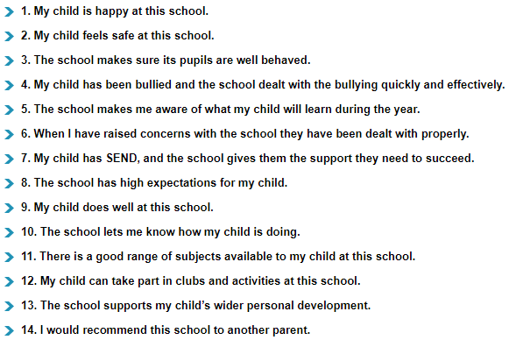
Ofsted ParentView
https://parentview.ofsted.gov.uk/
Notes:
Back to Victoria for this slide and closing remarks

Slide 19
The Year 7 pastoral team
Head of Year: Mrs Burgess​
Assistant Head of Year: Mr Roberts​
Deputy Principal: Mr Sycamore​
​
Tutors ​
7C – Mrs Goodson and Miss Van De Graaf in Art2​
7O – Mr R Law in Ma1​
7M – Mr Winter in Ma4​
7B – Mrs Allen and Mr Shelley in Ma2​
7I – Miss Sankaran in Ge3​
7E – Miss Everitt and Mr P Law in Ma7​
7R – Mr Collier in Ma3​
7T – Mr Garton in Ma5​
7N – Ms Dunn in Ma6​
7V – Miss Allinson in Ge2​

